Slide 1
Credit EDA Case Study
By – Sahithi Priya
Yash Sharma

Slide 2
PROBLEM STATEMENT
Data collected from Bank contains the information about the loan application at the time of applying for the loan. It contains two types of scenarios:
The client with payment difficulties: he/she had late payment more than X days on at least one of the first Y instalments of the loan in our sample
All other cases: All other cases when the payment is paid on time. The company wants to understand the driving factors (or driver variables) behind loan default, i.e. the variables which are strong indicators of default.
The company can utilize this knowledge for its portfolio and risk assessment.

Slide 3
OBJECTIVE
Performing EDA analysis to uncover hidden insights of data and identify patterns or features present in datasets using various EDA tools , like statistics and visualization techniques.
Through extensive EDA techniques we shall extract meaningful data for analysis of loan risk factors.
We will frame inferences with data prepared through various statistics and visualization charts to gain maximum knowledge of loan data.

Slide 4
Exploratory Data Analysis Flow
EDA
Data Cleansing
Data Analysis
Inferences
Missing value Replacement, Duplicates check, Data types check, Outlier Analysis, Normalization , Scaling/Binning the data
Univariate Analysis, Bi variate Analysis, Multivariate Analysis, Correlation Analysis
Statistics and Insights of Data Analyzed

Slide 5
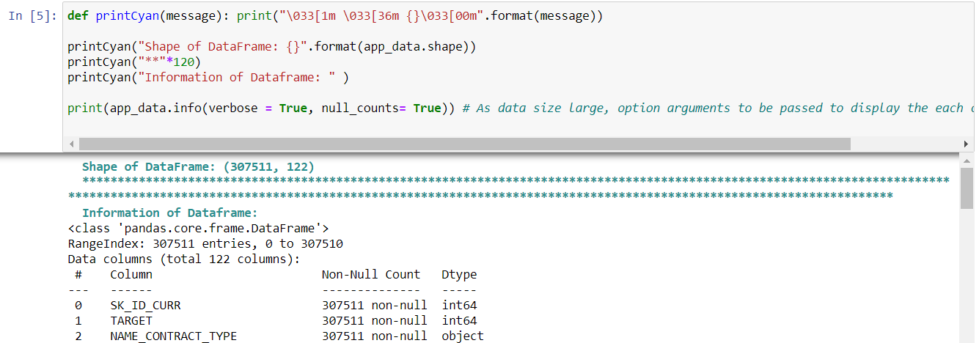
Data Cleansing
Reading the Files into individual data frames
Application Data
Application data file contains frame size of (307511,122)
From info() method we could clearly observe difference in columns record count which is due to Null entries.
Previous Application Data
Previous Application data File contains frame size of (1670214,37)
From info() method we could clearly observe difference in columns record count which is due to Null entries.
Also reference column in both data frames is “SK_ID_CURR”

Slide 6
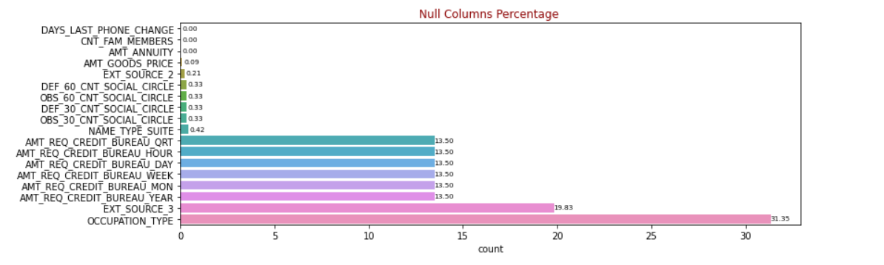
Missing Value Treatment
Identifying Null Counts or Percentages in Frames
1. We could see there are around 49 columns with missing records percentage above 40%, among these columns we see most of columns specific mode, median, avg of client location details(apartment size, no of elevators, floors etc).
2. Since these have most of missing records either from client side or data sourcing issue which is unknown, so we shall drop these columns at this point to avoid additional features.

Slide 7
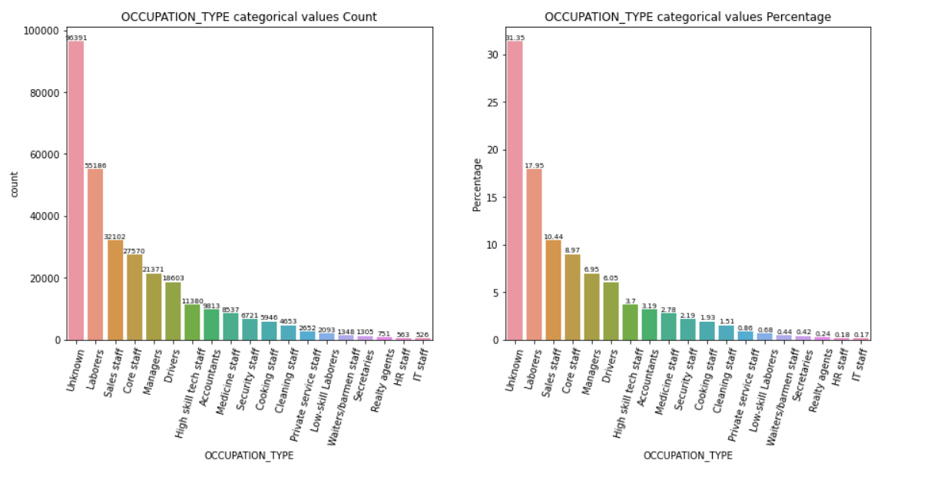
Handling Missing Values
Categorical Columns
NAME_TYPE_SUITE column, the Null count in the Column is significantly lesser so we shall replace values with the mode of distribution.
Occupation Type , since Null count in the Column is significantly higher than mode of distribution, to avoid skewedness and imbalance dataset within categories we shall create new category currently as "Unknown"

Slide 8
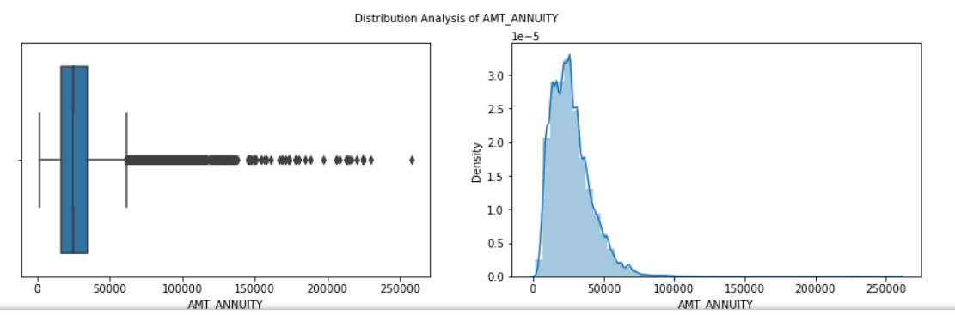
Numerical Columns
Through Distribution and Box plots, statistical values, AMT_ANNUITY, AMT_GOODS_PRICE graphs tend to be left skewed so better we take median to replace Null values. CNT_FAM_MEMBERS tend to be right skewed, we shall take median.
EXT_SOURCE_2/3 and DAYS_LAST_PHONE_CHANGE have right skewed distribution so we shall consider median.
AMT and Social Circle columns shows left skewed therefore we shall consider median.

Slide 9
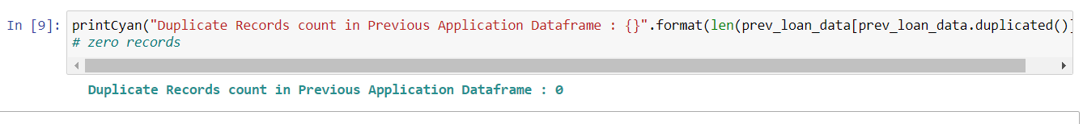
Duplicates Record check
Application Data
Previous Application Data

Slide 10
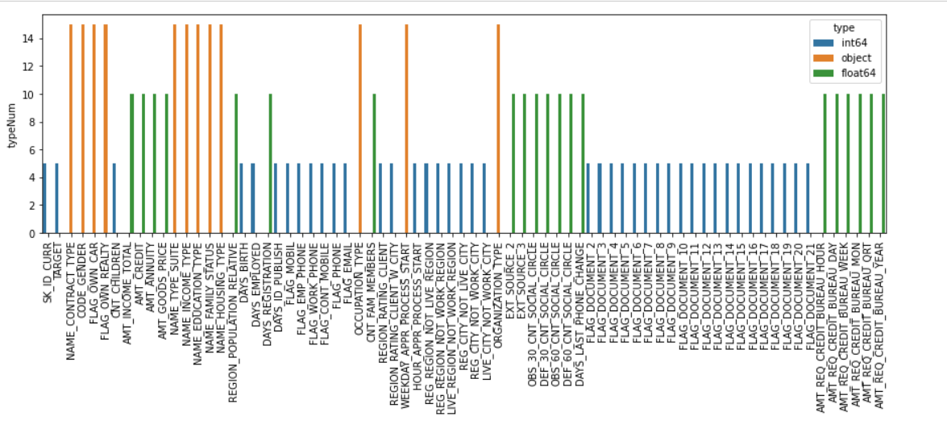
Data Type check
Plotting Bar chart to identify data types of each column and analyze respectively.
Columns specific to Flag are found to be discrete numerical values as 0/1 pairs to N/Y, but FLAG_OWN_CAR, FLAG_OWN_REALTY tends to follow N/Y only so let us change to type to discrete numerical
Columns specific to Days present in Integer as these are whole values summarising count of days, except DAYS_REGISTRATION ,DAYS_LAST_PHONE_CHANGE which exist in float.
CNT_FAM_MEMBERS Column found to be in float though it is set of whole values defining count of family members.
Days column are in negative which to be modified by absolute representation of them

Slide 11
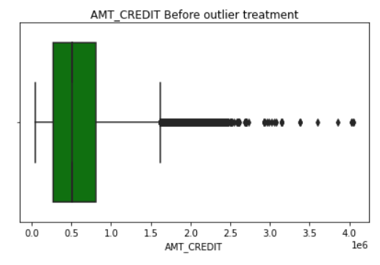
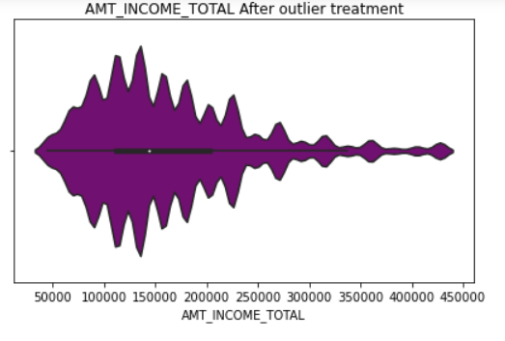
Outlier Analysis
Numerical Columns
Analysing the numerical columns outlier percentage ,Skew(must be between -1 and 1) till k factor/whisker width of 3 which defines extreme values/outliers.
The columns contain high outlier percent at 3 std and high skew value, either due to data issue or junk, therefore we shall drop the columns to avoid further analysis
We have dropped columns with outlier percentage is more 1% or whisker width *3 and have less significance.
Flooring and Capping Technique:
For other columns we have dropper records with outlier percent greater than3 and used flooring & capping the values at (1%, 99%) percentile on extreme outliers less than 1% quantile with 1% quantile , similarly for far outs to 99% quantile.

Slide 12
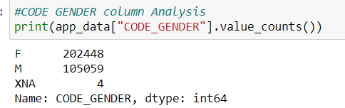
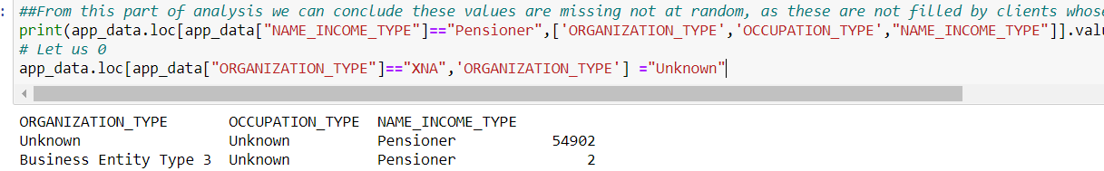
Categorical columns
CODE_Gender column: Replacing XNA with mode of distribution since Female has high frequency value and XNA does not mean any value.
Occupation Type Column: From analysis , we can observe these values XNA not found for random observations, as these are not filled by clients whose income type is Pensioner. Therefore replace these values with specific column value as "Unknown" defining Pensioners

Slide 13
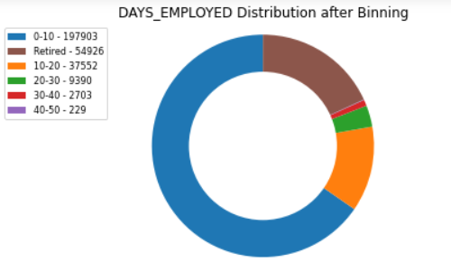
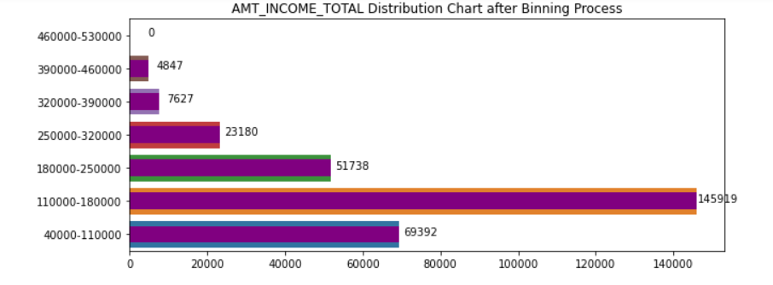
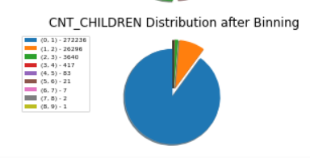
Scaling/Binning of Columns
Binning the DAYS_XXX, CNT_XXX, AMT_XX(Not REQ) columns to understand better insights from them and also to support in future analysis.

Slide 14
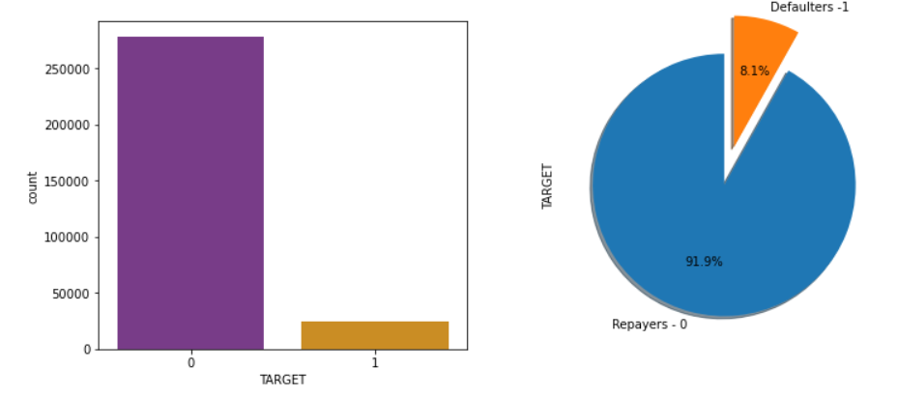
DATA ANALYSIS
Univariate Analysis
DATA Imbalance :
We could see that there is high distribution of records tends towards Target variable 0 than 1 , therefore imbalance exist in these 2 classes i.e. Payers with and without payment difficulties.

Slide 15
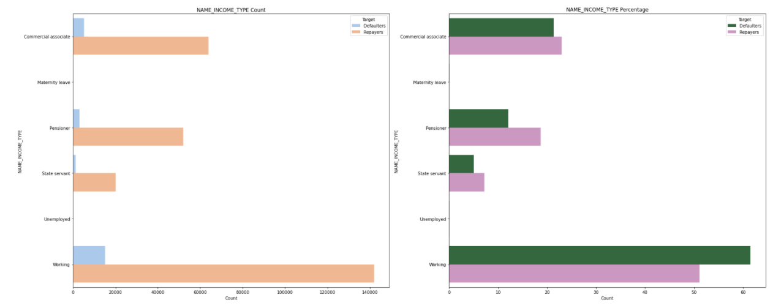
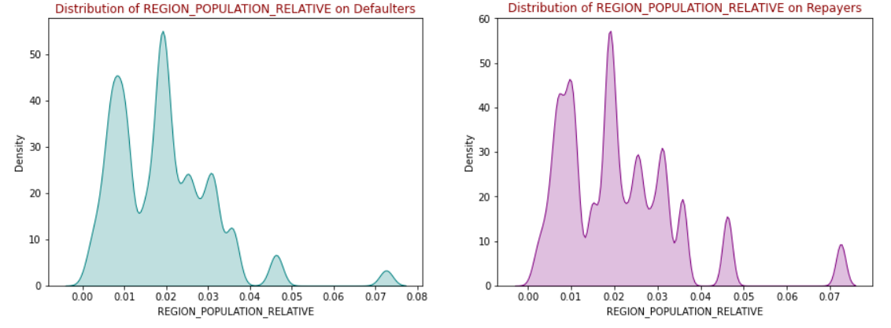
BIVARIANT ANALYSIS
Perc of unaccompanied clients have higher defaulters than repayers.
Defaulters rate is found to be higher than repayers in Working category, lesser ratio in State Servant.
Defaulters percent is higher than repayers in Secondary/special, lesser in Higher education.
Defaulters perc is greater than repayers in Single/not married and civil marriage.
High Default percentage is found in people staying with parents than repayers.
Defaulters percentage is higher in Labourers followed by Sales staff, in both defaulters rate is higher than repayers.
Defaulters perc. is higher in Business Entity Type3 followed by self employed, in both defaulters rate is higher than repayers.
Retired employers tends lesser ratio indication of successful repayment. Also defaulters tend to decrease with increase in employers experience
Lesser than age of 40, defaulter rate increased with days birth indicating young people facing higher payment difficulties.
Defaulters percentage ratio to repayers increases as CNt_children, Cnt_family increases.

Slide 16
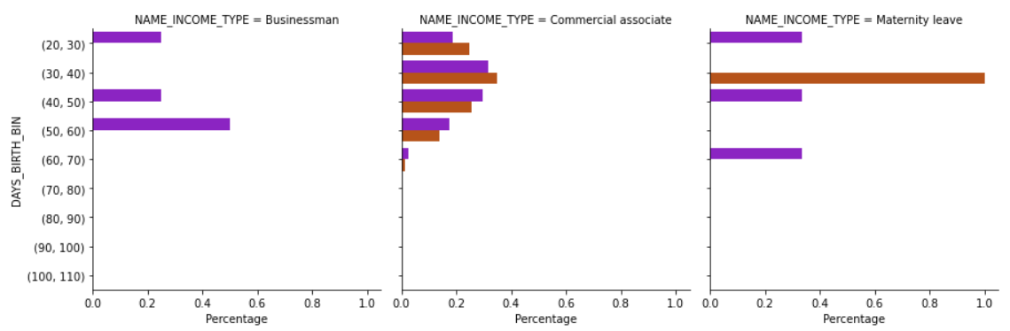
MULTIVARIANT ANALYSIS
Males has higher defaulter percentage than Females on both category of loans.
Student and Businessman tend to have significantly less/no defaulters irrespective of gender/age, women on Maternity leave tend to have high defaulters percentage than repayers.
Retired employers have no defaulters, indicating the repaying payment without difficulties percentage is more at high aged clients.
Irrespective of Education type, males tend to have higher defaulters to repayers ratio, whereas females from Academic degree has this ratio higher than others

Slide 17
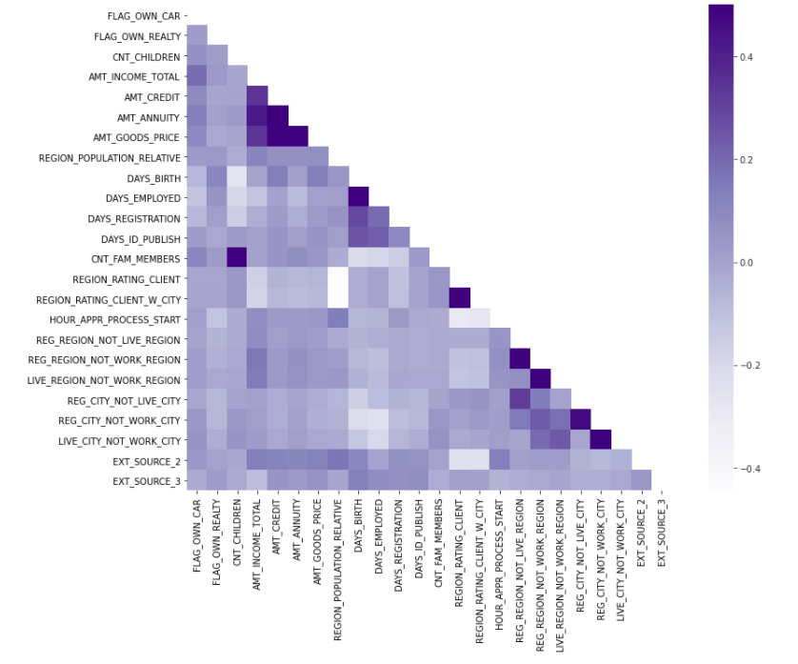
CORRELATION ANALYSIS
AMT_GOODS_PRICE and AMt_Credit are highly correlated, means higher the AMT_GOODS_PRICE people are applying higher credit of loans.
Family Numbers and children positively correlated this is behavioural observation. Also Days employed and days birth also positive correlated feature.
We could observe AMT_GOODS_PRICE & AMT_ANNUITY , AMT_Credit & AMT_ANNUITY highly correlated indicating all 3 has a direct relationship.
Region Population relative is negatively correlated with region rating columns, higher region rating lower the population relative.
Similarly Ext Source columns are as well negatively correlated with Region rating columns.

Slide 18
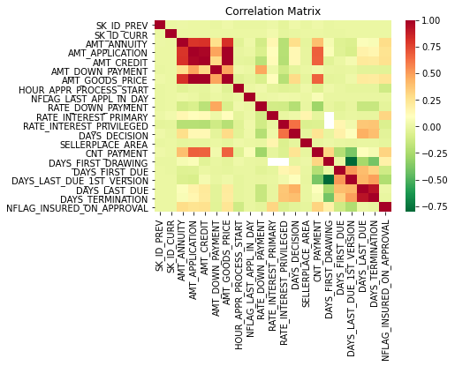
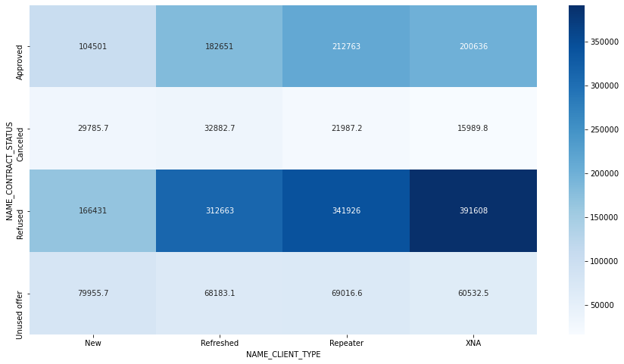
Data Analysis after Merge

Slide 19
Finding
The unused offer application amount is low
The cancelled application volume is huge. Firm may be refusing these possibly as the Debt liability ratio of the consumer must be going high due to the high amount and thus credit default risk.
Repeater's application quantity is rise than the Undecayed clients. This may symbolise that the firm has more favourable policies/rates of earnings etc for repeat candidates
Similary, AMT_Credit to AMT_GOOD_PRICE also the correlation is high
Considering Target 1 is the default, more crucial on the above pattern explicates association to default consumers.
An employed candidate with Approved status possess defaulted in the greatest figures
Previous applications with Refused, Cancelled, Unused loans with a default status is the looking area. This indicates that the financial corporation had Refused/cancelled the previous application, but has passed the current and is risking on these investments.
Candidates of working-class were REFUSED previous and forthwith become defaulted is the main problem in system .

Slide 20
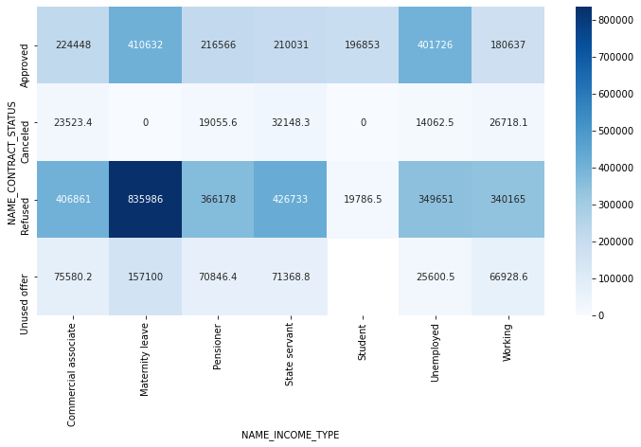
Correlation after merge
Higher credit offered to unemployed, maternity leave is a notable factor
Unused offers have smaller credit values and possibly the reason why applicant is not using them

Slide 21
INFERENCES
1. 7.5% of Approved loans have defaults
Low Risk Loan Factors:
Students were found to be noble repayors, considering numerous factors of employment succeeding their education.
Similarly, businessmen, State servants, Pensioners are unusual repayors with none or fewer complications of the mortgage.
Consumers with long employ experience and age observed to be a tremendous percentage of repayors with no challenges.
High Risk Loan Factors:
Personalities staying with parents, on maternity leave are found to be big defaulters.
People with income amount trifling than amount credit holds high defaulters.
Consumers with less experience and age were found to have a large defaulters rate.
Professionals with jobs as Labourers, Sales staff and Drivers with more economical income conditions conduce to hold large debtors, opposed to people of noble income such as IT, HR staff etc.

